Slide 1
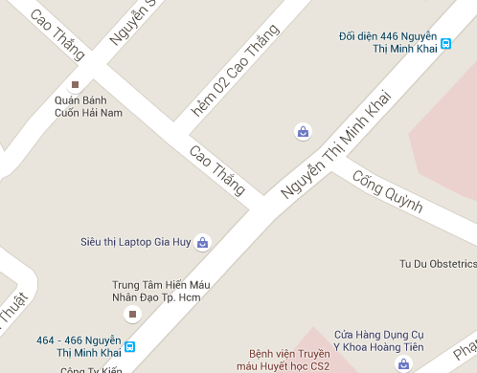
Scenario
Nickname of Mr. Khuong is “Khuong không sợ chết”.
Mr. Khuong always drives with high speed.

Slide 2
Scenario
Nickname of Mr. Khuong is “Khuong không sợ chết”.
Mr. Khuong always drives with high speed.

Slide 3
He is notified when he near next turn.
Notify: prepare to turn left

Slide 4
But he passes it and keeps go straight.
He doesn't know that he has lost then he still drives.

Slide 5
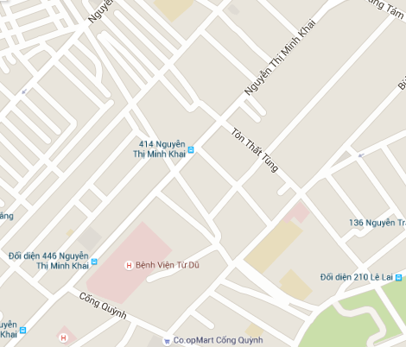

He has far away from right route when he checks map again.

Slide 6
Problem
Don’t has any application that allow users know if they are going to the wrong route.

Slide 7
Solution
Provide detect wrong route function.
Help users know if they are going to wrong route.
User can search again to get right route.

Slide 8
Detect wrong way algorithm
Notes:
thuật toán phát hiện sai đường.

Slide 9
E
A
C
D
B

Slide 10
Notify: wrong way
E
A
C
D
B

Slide 11
E
A
C
D
B

Slide 12
E
50
A
C
D
B

Slide 13
E
50
A
C
45
D
B

Slide 14
E
50
20
A
C
45
D
B

Slide 15
E
50
20
A
C
15
45
D
B

Slide 16
E
50
13
A
C
20
15
45
D
B

Slide 17
E
A
C
D

Slide 18
E
A
C
D

Slide 19
E
A
C
D

Slide 20
Notify:
E
A
C
D

